Slide 1


IWLP Student Representatives
Information slides

Slide 2
STUDENT REPRESENTATIVES
WHAT’S THE ROLE?
Class and module Reps represent the views of students on academic issues at programme and school level.
Reps work to ensure the student voice is being heard by the University and positive changes are being made throughout every department.
To find out more about Reps and to get involved head to rusu.co.uk/representation
IF YOU RUN FOR A ROLE AND ARE SUCCESSFULLY ELECTED, YOU’LL BE JOINING 400+ LIKE-MINDED STUDENT REPS!

Slide 3

What’s involved?
Liaise with students, gain feedback and represent the student voice
Work alongside other Course Reps, School Reps and the RUSU Education Officer
Work in partnership with University staff to create positive changes to your course
Attend Course Rep Consultations with RUSU Academic Rep Coordinator

Slide 4
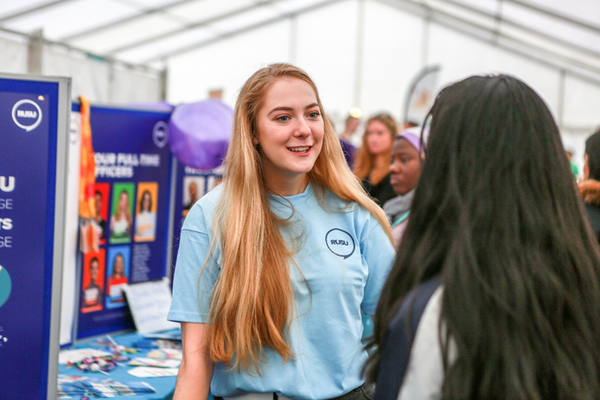
What’s in it for me?
Work with and on the behalf of students on your Course
Receive training and develop your transferable skills
Network and build relationships within the University & the Students’ Union
Gain excellent career–boosting experience to enhance your CV and LinkedIn profile
Volunteering hours count towards your RED Award and make for great interview talking points
Exclusive opportunities for Reps to sit on Scrutiny and Periodic Review panels (paid roles)!

Slide 5
RUSU Course Rep video
A MESSAGE FROM YOUR RUSU EDUCATION OFFICER
PLAY VIDEO
https://www.youtube.com/watch?v=Z8fGwy7K9l0

Slide 6

class representatives – to be elected by 25 Oct 2019
Attend at a training session in the Autumn Term, run by the RUSU (Reading University Students’ Union) Education Officer (only 2 hours’ training is needed);
Read documents from Student Staff Liaison Committee blackboard and familiarise with the process. (1 hour)
Represent the whole class and collect the feedback of the class and write a report in Spring term (1 hour).
Meet with the module representative, if the module has more than one class, to discuss the issues that your class has raised (1 hour).
Total 5 hours

Slide 7

module representatives – To be elected by W10 6 DEC 2019
Attend at a training session in the Autumn Term, run by the RUSU (Reading University Students’ Union) Education Officer (only 2 hours’ training is compulsory);
Read documents on Student Staff Liaison Committee blackboard and familiarise with the process. (1 hour)
Represent the whole class and collect the feedback of the class and write a report in Spring term (1 hour).
Meet with the other class representatives of the module, if the module has more than one class, to discuss the issues that they have raised (1 hour) and write a report to IWLP Student-Staff Liaison Committee (1 hour)
Attend at the IWLP Student-Staff Liaison Committee meeting in February (2 hours).
Total 8 hours

Slide 8

IWLP Rep- To be elected by 1 Feb 2020
All elected module representatives will have the opportunity to put themselves forward for election to the IWLP Board of Studies, which meets once a term to review IWLP events, policies and procedures. (Two student representatives are elected to the Board.)
additional 6 hours

Slide 9
Training once elected
Training opportunities to further introduce you to the role and arm you with tools to get going…
Initial induction sessions held between 29th October & 8th November 2019 in the Autumn term
Meanwhile, there will also be lots of resources online on the RUSU website under the Rep Hub which will include handbooks and training slides to help you with your role.

Slide 10
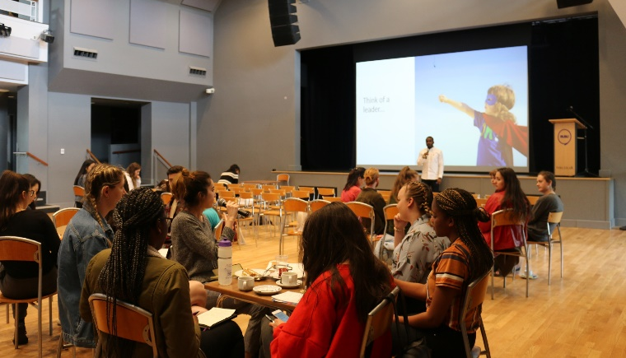
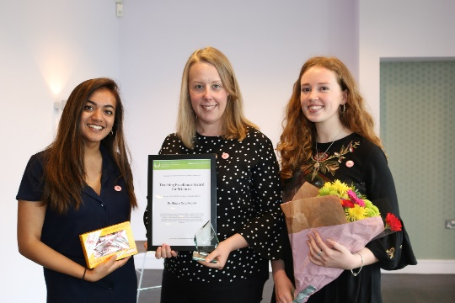
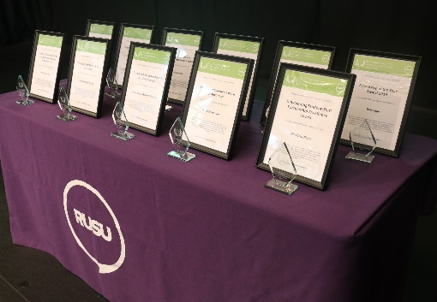
Further development opportunities & employability workshops
Annual Representation Conference held in January (New date!)
A chance to catch up, bespoke workshops, plus free lunch, guest speakers, goodie bag and chance to network! Not to be missed – save the dates 25th Jan or 1st Feb!
Rep exchange project coming soon (series of employability workshops) focussing on resilience building, leadership & communication skills - late Spring term
All new You’re Excellent! recognition Scheme in Association with the RUSU Excellence Awards – all year round!
RUSU Teaching and Learning Showcase 2020 (Course and School Rep of year awarded) – end of April

